Slide 1
Building Trust with Children: Understanding Healthy Attachment
Mental Health Association of Maryland and For All Seasons
January 16, 2025
Lesa Mulcahy, LCSW-C
Chief Clinical Officer
Notes:
1

Slide 2
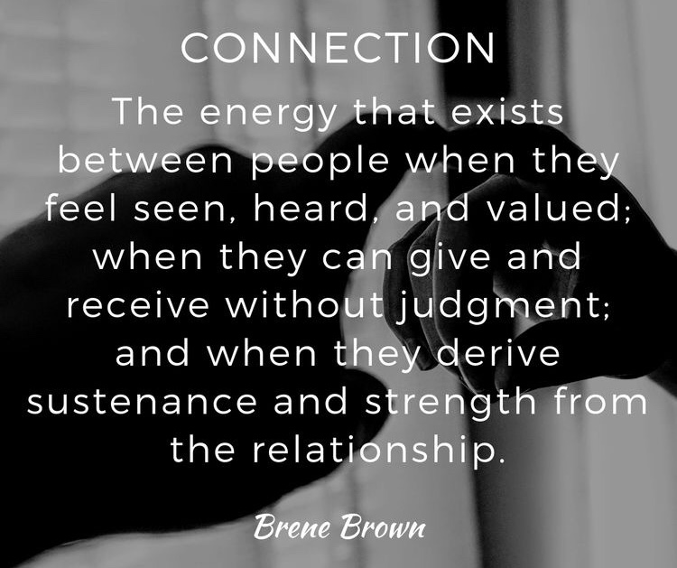
Coffee Girl or Social Worker?
Coffee Girl or Social Worker
©2025, For All Seasons, Inc.
Notes:
a. Sticky note exercise – Permission slips

Slide 3
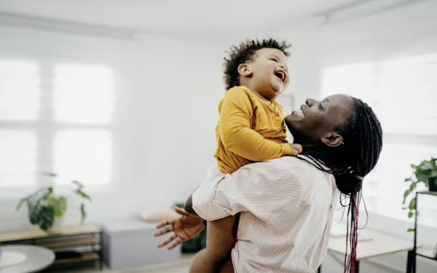
What is healthy attachment and why is it so important?
Emotional connection that develops between a child and their caregiver, forming the foundation of the child’s social and emotional development
Dan Hughes, psychologist
©2025, For All Seasons, Inc.
Notes:
(solo activity, no shareout)
Hand out the leadership manifesto and highlighters.
Ask participants to highlight any sections or phrases that resonate or stand out.

Slide 4
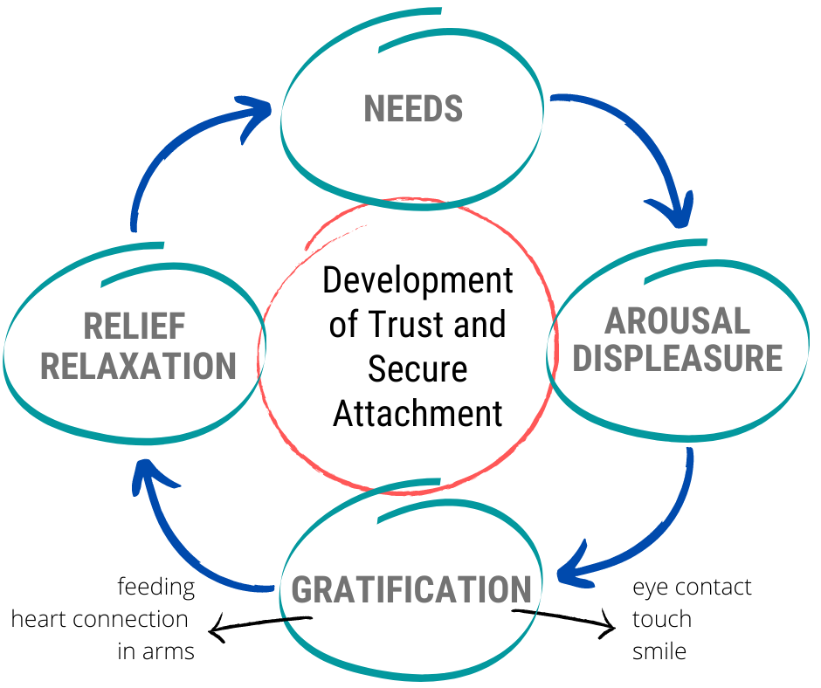
Repetitive and consistent: not perfect interactive between caregiver and infant Internal working model: I am safe My caregivers are safe My world is safe
©2025, For All Seasons, Inc.
Notes:
This image credit: https://evergreenpsychotherapycenter.com/about-us/
Dr. Levy
Container building activity.
c. Container building – Big and little stickies (4 different colors, same pens)

Slide 5
Actions or signals displayed by an infant or young child to seek proximity, comfort or reassurance from their primary caregiver.
These behaviors are a natural part of the attachment process and ensure the child’s emotional and physical needs are met as well as establish a sense of security.
Attachment Seeking Behavior
©2025, For All Seasons, Inc.
Notes:
ACTIVITY:
Split into 4-5 groups (depending on overall size).
Give each group a poster-size sticky note and poster markers.
Follow the instructions on the slide.
When the groups are done brainstorming, hang all the post-its side by side on a wall.
Next, give EACH PERSON (not each group) a sheet of dots.
Ask them to get up from their chairs and put a dot on the leadership behaviors they have experienced (both good and bad).
As a large group, debrief and discuss.

Slide 6
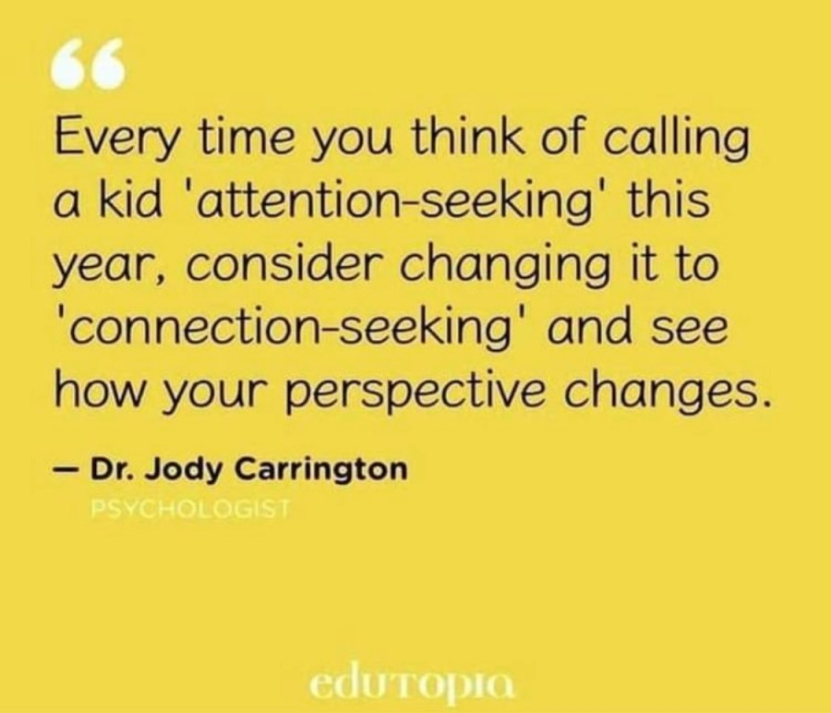
©2024, For All Seasons, Inc.
Notes:
E. Working definition of leadership – slide with Brene definition “definition of a leader”
i. Is there anything else you would want to put on this?
ii. Broaden the definition of who is a leader (we all can be)

Slide 7
Ed Tronick
©2025, For All Seasons, Inc.
Notes:
f. Role of vulnerability in courageous leadership
Myths
VIDEO: Brené Brown: The Biggest Myth About Vulnerability | Inc. Magazine
Large group conversation after video:
“What makes it hard to show up, be seen, and take that risk of being vulnerable?”
HANDOUT:
vulnerability worksheet complete worksheet solo,
small group share out

Slide 8
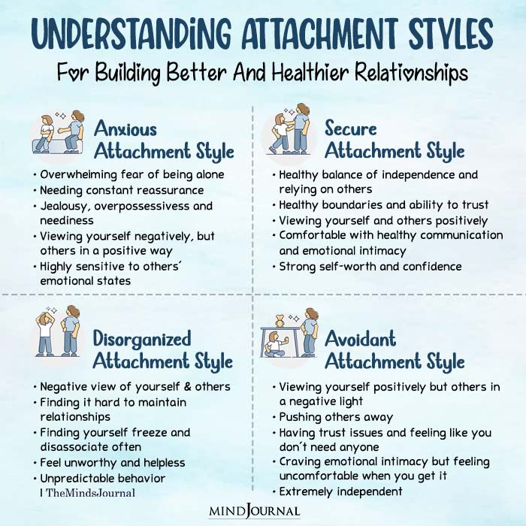
Attachment Styles
©2025, For All Seasons, Inc.
Notes:
g.
i. Self awareness: Recognizing and understanding your own emotions
ii. Self regulations: Managing emotional responses
iii. Social awareness: understanding others’ emotions and perspectives
iv. Relationship management: effectively interacting with and supporting others

Slide 9
What can I do?
Educate yourself on attachment theory
Find an attachment therapist
Small moments to build trust
©2025, For All Seasons, Inc.
Notes:
(solo activity, no shareout)
Hand out the leadership manifesto and highlighters.
Ask participants to highlight any sections or phrases that resonate or stand out.

Slide 10
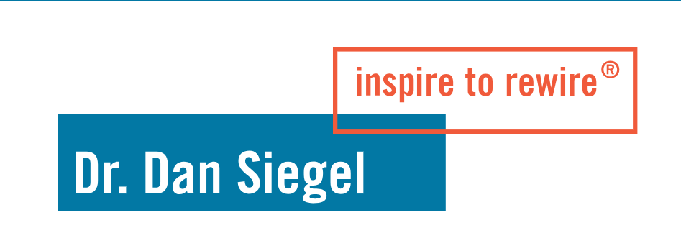
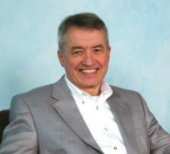
https://www.childtrauma.org/
https://attach.org/
Resources
https://drdansiegel.com/
https://proactiveapproaches.co.uk/dan-siegels-4-ss-of-secure-attachments/#:~:text=Overview%20of%20Dan%20Siegel's%204%20S's%20of%20Secure%20Attachments&text=These%20four%20elements%20%E2%80%93%20Safe%2C%20Seen,develop%20healthy%20and%20secure%20relationships.
https://ddpnetwork.org/about-ddp/dan-hughes-founder/
©2025, For All Seasons, Inc.
Notes:
ACTIVITY:
Split into 4-5 groups (depending on overall size).
Give each group a poster-size sticky note and poster markers.
Follow the instructions on the slide.
When the groups are done brainstorming, hang all the post-its side by side on a wall.
Next, give EACH PERSON (not each group) a sheet of dots.
Ask them to get up from their chairs and put a dot on the leadership behaviors they have experienced (both good and bad).
As a large group, debrief and discuss.

Slide 11
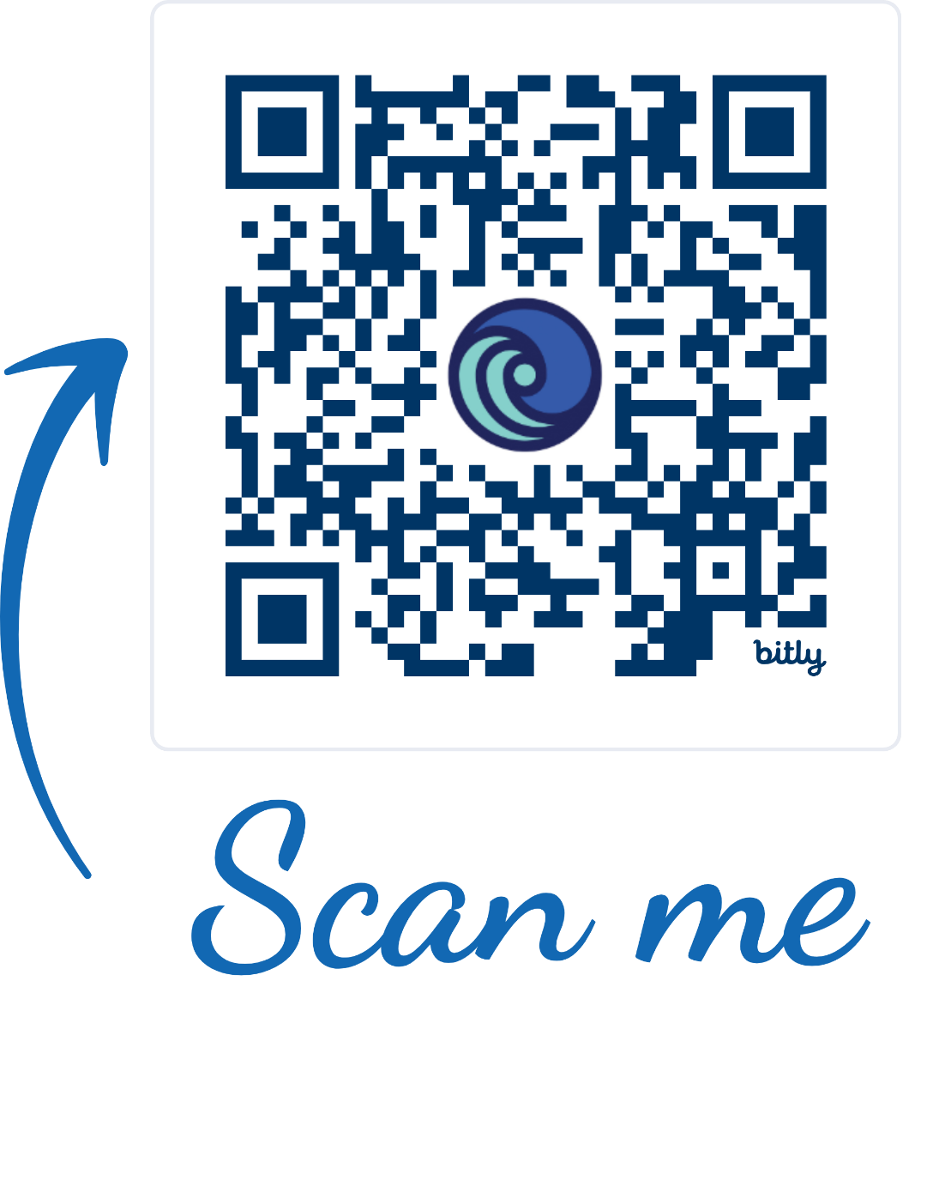
Stay in Touch!
https://supportforallseasonsinc.org/CFL
©2025, For All Seasons, Inc.
Notes:
(solo activity, no shareout)
Hand out the leadership manifesto and highlighters.
Ask participants to highlight any sections or phrases that resonate or stand out.

