Slide 1



Children’s Mental Health Matters
Poster Contest
1

Slide 2

History
Each year, Maryland Coalition of Families hosts a poster contest as part of the Children's Mental Health Matters campaign, an initiative to raise awareness of and decrease stigma surrounding children's mental health.
2

Slide 3
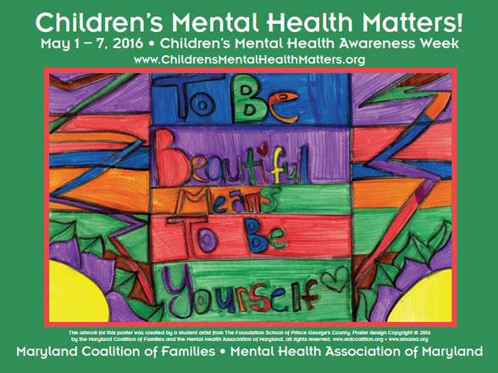
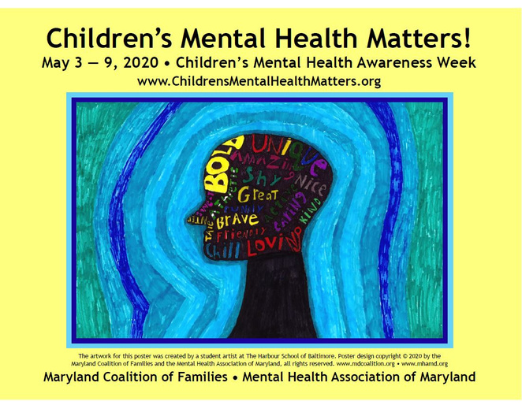
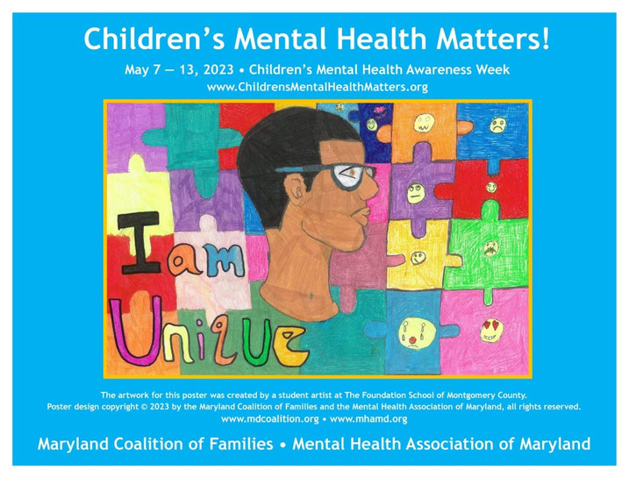
Empowering Youth
Maryland youth are invited to showcase their voices by contributing artwork, providing a platform that fosters creativity and promotes advocacy through art.
3

Slide 4
Participation Details
Open to all Maryland students up to age 18!
Artwork is collected electronically: mcf.family/cmhm-poster-contest
Artwork Specifications
Artwork that uses vibrant, eye-catching visuals to bring attention to and promote acceptance of mental health challenges, while inspiring others and combating stigma.
4

Slide 5
Artwork Specifications Continued...
Format:
  Landscape orientation (horizontal)
  11" x 17" preferred; 9" x 11" will work
  Background should be filled in and empty space kept to a minimum
  Two-dimensional artwork only
  Artists may collaborate on a piece of artwork
  Completed consent form must be included for each submitted artwork
5

Slide 6
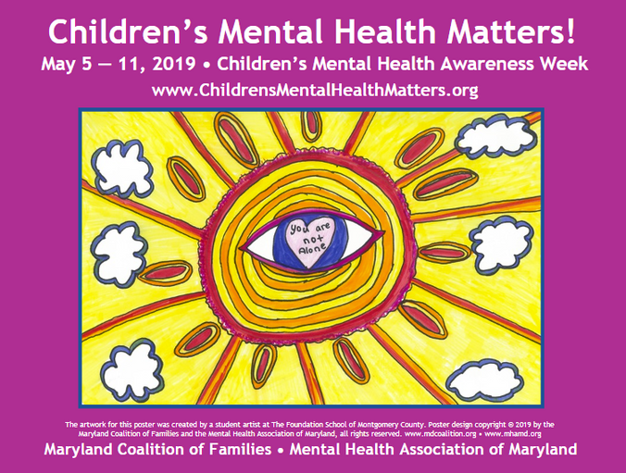
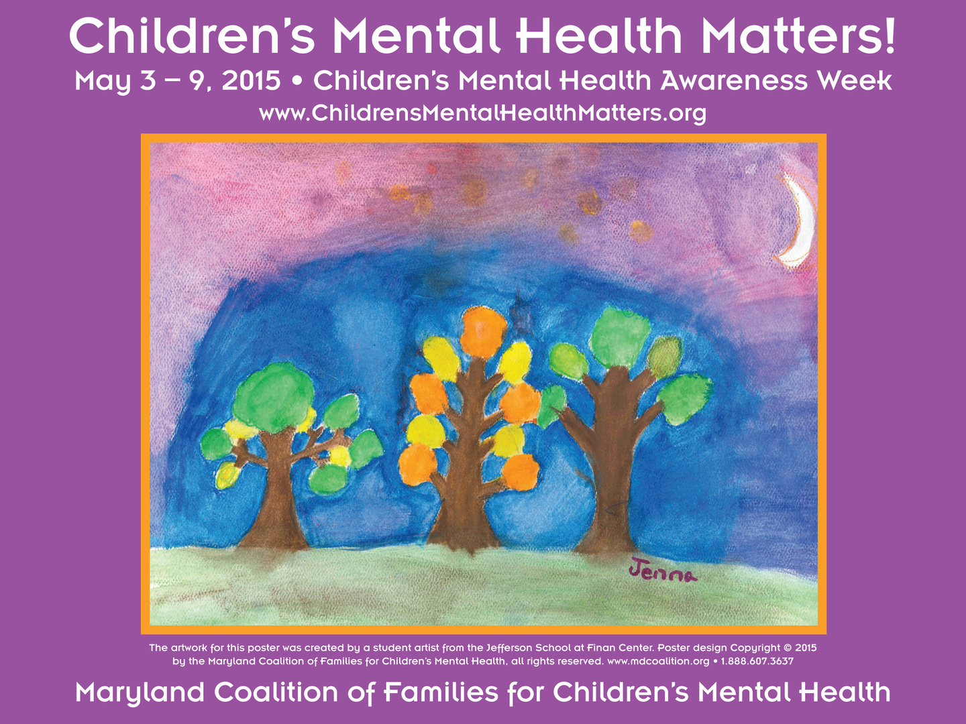
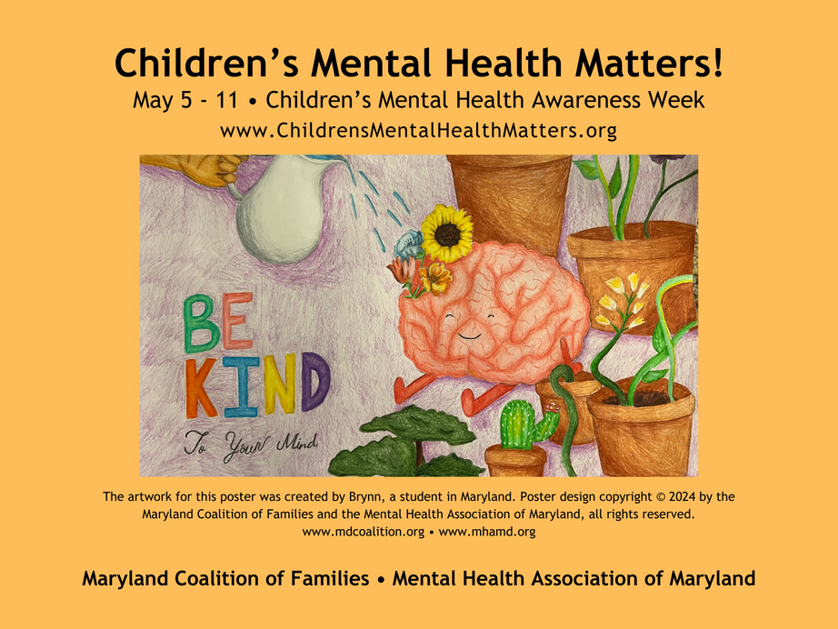
Selected artwork will be featured on the 2025 Campaign poster!
6

Slide 7
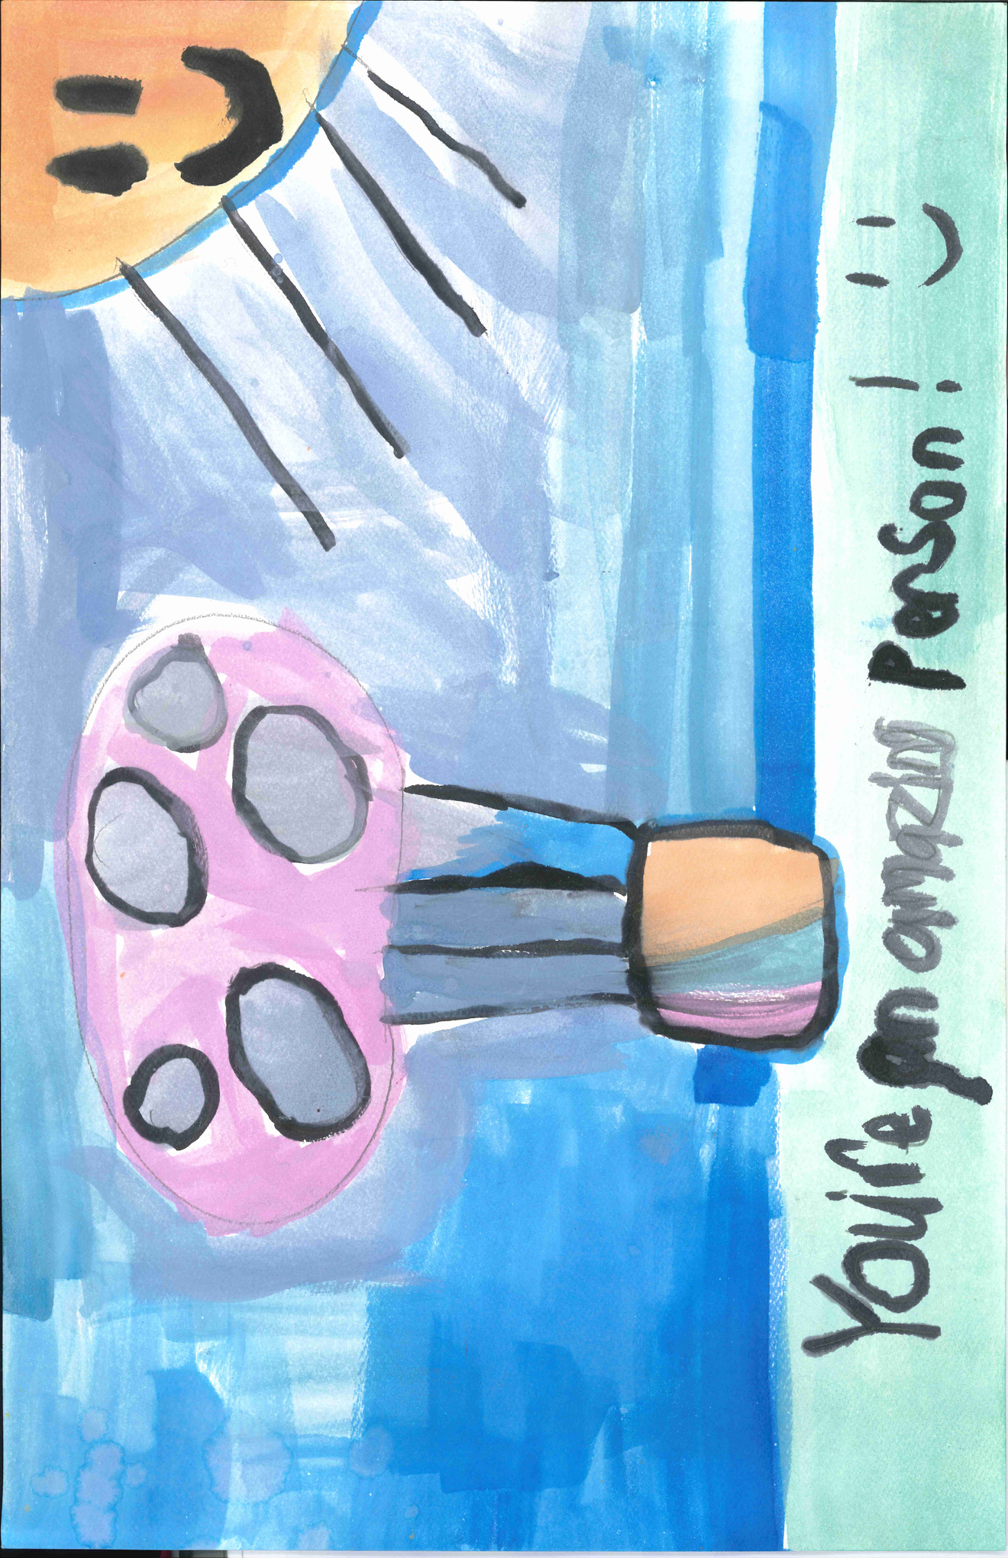
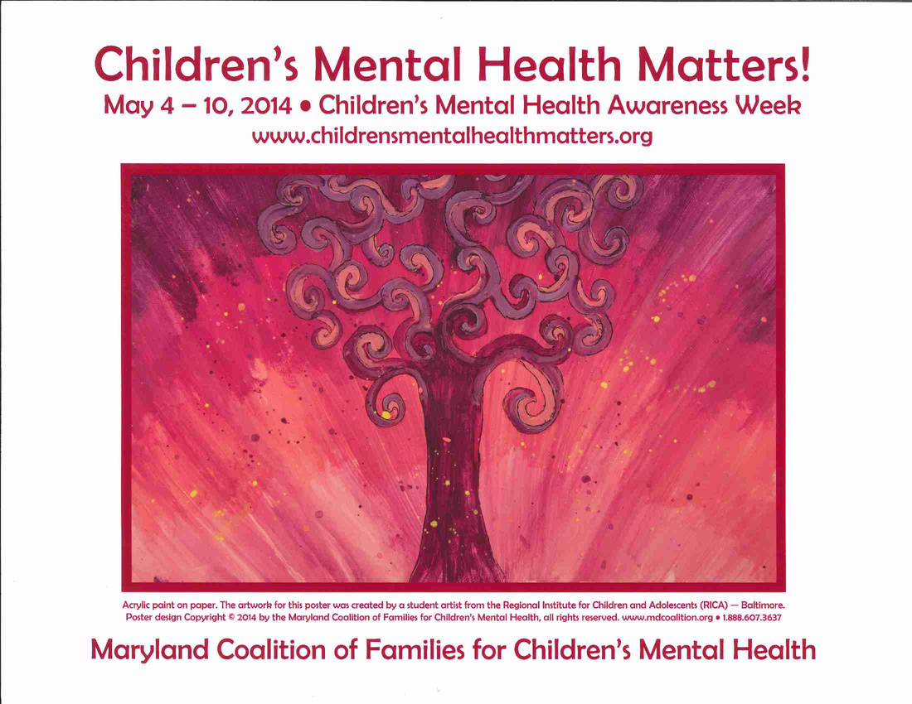
Winning artwork throughout the years...
7

Slide 8

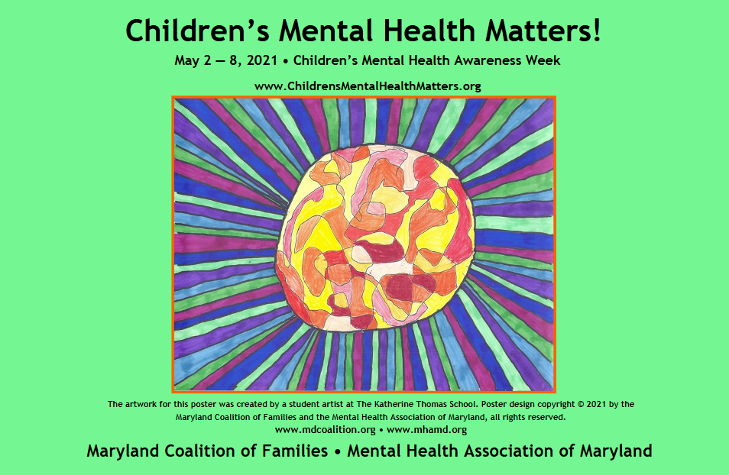
8

Slide 9
Questions about the campaign?
Contact: Haley Rizkallah at cmhm@mdcoalition.org
9

