Slide 1
Mental Health During the Holidays
Alli Cope, LCSW-C

Slide 2
GBCC/Oasis Behavioral Health
Locations in MD and VA!
Outpatient mental health services
Individual
Couples/Families
Groups
Medication Management
Urgent Care
4 Locations in MD and VA
In person and telehealth offered
Glen Burnie, Annapolis, Odenton, Timonium, Reston

Slide 3
Goals for Today
Identify common stressors during holidays and normalize boundaries.
Complete a fun winter activity that can be used to reduce stress!

Slide 4
Contributing Factors to Holiday Stress
Pressure and many things to do
Grief and loss
Obligations and expectations
Financial stress
Challenging family dynamics
Add more to the chat!

Slide 5
Setting Boundaries
It’s okay to take space and ask for what you need!
Time away or breaks during gatherings
Have a support system prepared
Express needs/expectations beforehand and prepare to reinforce as needed
Pre-plan responses
Other ideas?

Slide 6
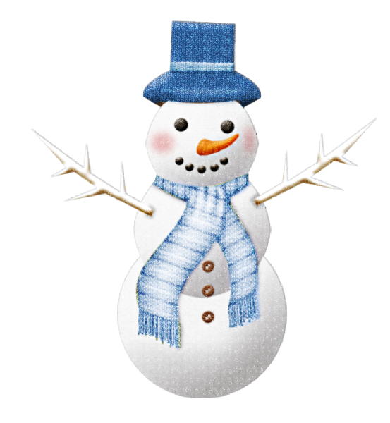
Snowman Mindfulness
A grounding and stress reducing activity.
Engage the senses to become more in the present
What do you notice about the snowman when you look at him?
What does the snow feel like?
What does the air smell like around?
You can do this as a visualization, as you are making a snowman, before a meal, any time!

Slide 7
Other Helpful Resources
211 Maryland
988 Crisis Helpline

Slide 8
Thank you &
Happy Holidays!

