Slide 1
Mental Health Crises and How To Help

Slide 2
Today’s Presenters
Jennifer Grinnell, LCPC
She/Her
Director, Community Education
Laura Laskofski, MPH
She/Her
Manager, Community Education

Slide 3
EveryMind
65+ years serving Montgomery County
Largest provider of school-based mental health services in Montgomery County
Programs and services for the entire lifespan – from young children to older adults
Community education on mental health and wellness topics including Mental Health First Aid
Expanding our reach across the National Capital Region
Notes:
Quick overview on EveryMind:
We provide a variety of direct services for the entire the lifespan
This includes 24/7 hotline, homeless outreach, school-based mental health services, and much more
We also strive to reduce the stigma surrounding mental illness and increase the importance of mental wellness for EVERYONE
Refer to our one-pager or direct them to our website if they'd like more information.

Slide 4
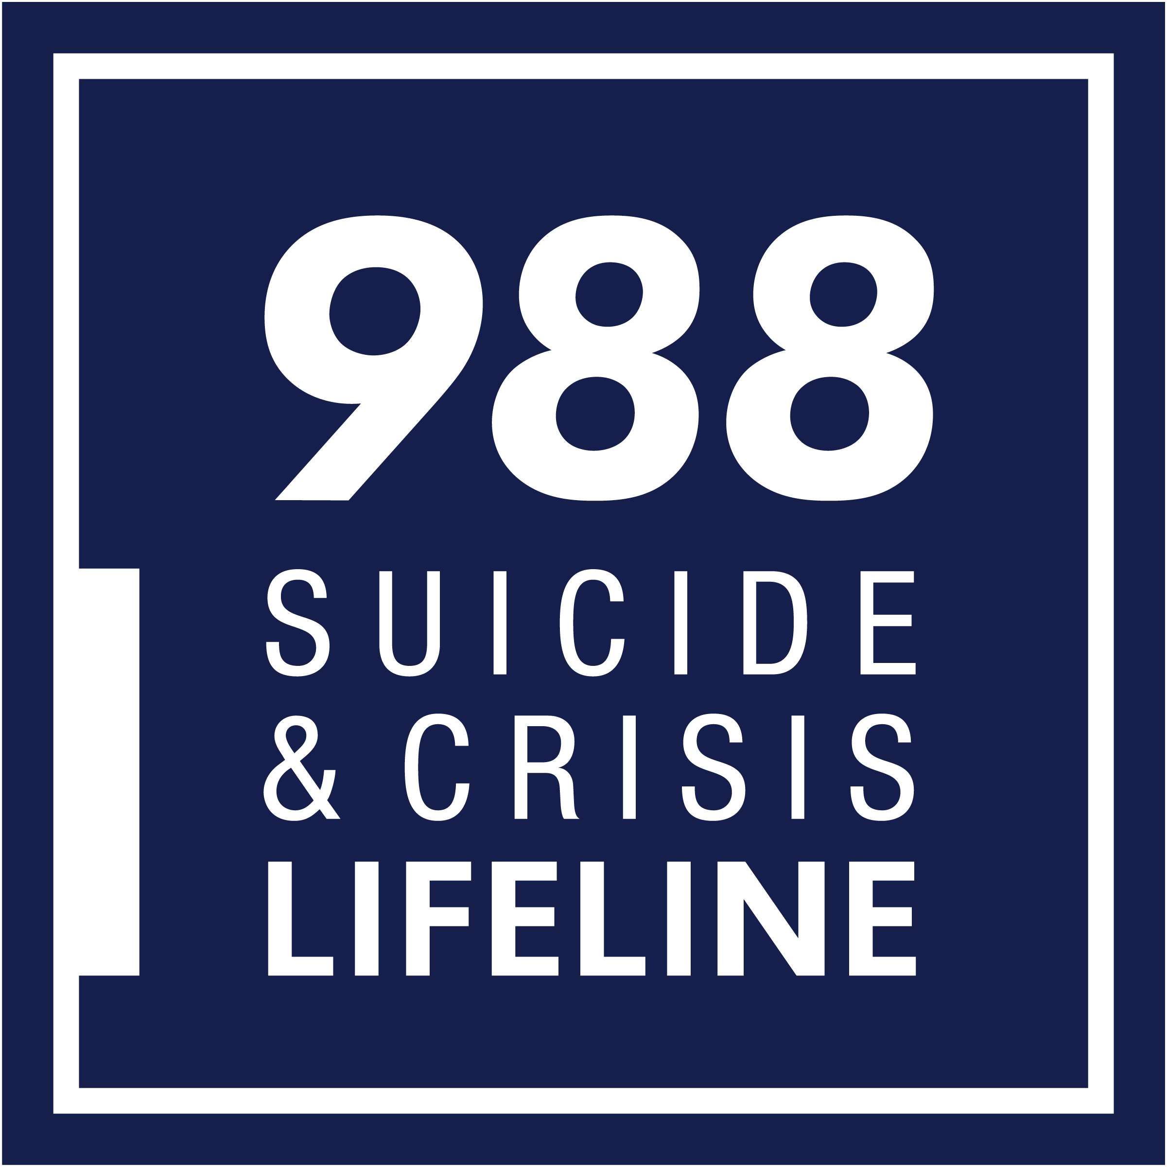
Hotline Services – We are here to listen
Accredited by the American Association of Suicidology
Local center for 988
Free and confidential
24/7 phones: 301-738-2255
24/7 call or text: 988
24/7 Chat: 988lifeline.org
Funded by Montgomery County, state of Maryland, and individual donors

Slide 5
We don’t send intervention to everyone who calls
Notes:
Most calls are resolved without the need for intervention.
About 1% of people who contact 988 agree to have the crisis counselor call 911 because of serious risk to their life
In fewer than 1% of contacts, the crisis counselor must call 911 without the consent of the individual due to serious risk to life

Slide 6
Take-Aways From Today
You know how to be a good friend and how to be there for someone, but after today, you will know how to:
Know some of the common mental health concerns
Recognize when someone is in crisis - warning signs
How to listen...the way someone needs to be heard
Know what is and is not helpful when someone is in crisis
How to ask someone "are you having thoughts of suicide?"
How to handle crisis situations via social media platforms
Resources for you and your friends

Slide 7
Mental Health Conditions in Teens: The Numbers
31.9%
Anxiety
19.1%
Behavioral Disorders
14.3%
Mood Disorders
11.4%
Substance Use Disorders
15-20%
...of adolescents engage in self-harm
Source: Centers for Disease Control and Prevention (CDC).
Notes:
Provide a brief description of what these disorders might look like in adolescents; emphasize co-occurring nature of substance use and mental health conditions
Anxiety – nervous disorder, state of excessive uneasiness and apprehension. Typically, with compulsive behavior or panic attacks
Behavioral disorders – Attention Deficit Hyperactivity disorder (ADHD), Oppositional Defiant disorder (ODD). Can impact an individual's ability to function at school, at home, and even in social situations.
Mood Disorders – the elevation or lowering of a person’s mood, such as depression or bipolar disorder
Substance Use Disorders – occurs when the recurrent use of alcohol and/or drugs causes clinically significant impairment, including health problems, disability, and failure to meet major responsibilities at work, school, or home.
You don't need us to tell you that we experience mental health concerns throughout our lives. When we are teens, we tend to go through lots of changes – physically, mentally, emotionally, and just life changes in general.

Slide 8
Suicide By The Numbers – Nationally (2021)
In 2021, suicide was responsible for 48,000 deaths
That is 1 suicide death every 11 minutes
Suicide is the 2nd leading cause of death for people ages 10-24
LGBTQ+ youth are more than 4x as likely to attempt suicide as their peers
54% of Americans have been affected by suicide in some way
Sources: Centers for Disease Control and Prevention (CDC), American Foundation for Suicide Prevention (AFSP), & The Trevor Project

Slide 9
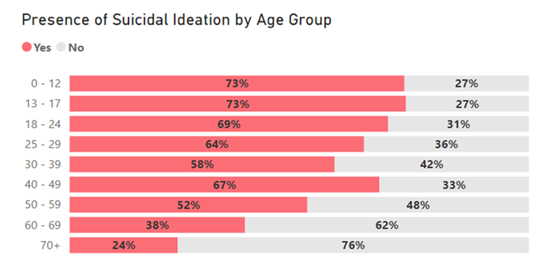
988 Contacts (Jan-Mar 2024)
Notes:
This data is from January through March of 2024, based on EveryMind's 988 contacts, youth reported suicidal ideation at the highest rates of any age group
26% of contacts under 12 and 18% of contacts 13-17 had harmed themselves that day

Slide 10
Swimming
https://swimmingshortfilm.com/
Notes:
Approximately 10 minutes
This is a video made by a MCPS student about their experience.

Slide 11
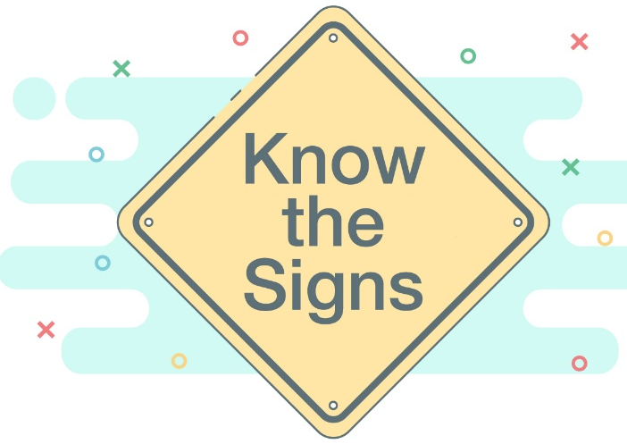
Warning Signs
Feelings of intense, on-going sadness
Inability to concentrate and difficulty making decisions (decrease in work efficiency)
Loss of interest in activities and friends
Withdrawal and/or isolating themselves
Thoughts of suicide or death
Changes in behavior and/or personality
i.e. no longer bubbly
Feelings of:
Guilt
Hopelessness
Worthlessness
Helplessness
Engaging in self-destructive or risk-taking behaviors
Sudden peace of mind
Notes:
WARNING SIGNS- 75 % OF PEOPLE GIVE WARNING SIGNS
Often each person sees one or two warning signs – but never put the whole picture together
mostly the same warning signs of depression
-What they might say:
“It doesn’t matter anymore”
“its all over”
“I can’t take it anymore” / wont take it anymore
“I’ve got to stop it”
“It’s done”
or statements like it will be suddenly better in the near future:
- “It won’t matter soon enough”
battle in their head
most people are not

Slide 12
Physical Warning Signs of a Possible Pending Mental Health Crisis
Changes in weight or appetite
Severe gain or loss
Changes in sleep behavior
Hyper-insomnia or insomnia
Changes in appearance
Fatigue or loss of energy
Excessive crying or crying easily
Ongoing severe headaches or muscle aches- physical symptoms

Slide 13
Behavioral Warning Signs of a Possible Pending Mental Health Crisis
Saying goodbye and/or giving away prized possessions
Running away
Statements of intent or a plan.
A statement of intent is a clear expression of suicidal thoughts
Having a plan is a thought-out plan of how they would end their life
Non-suicidal self-injury
May be a coping skill to reduce feeling intensity or to stop selves from dying by suicide
Prior suicide attempt
Actively seeking lethal means – asking where to buy a gun, seeking pills

Slide 14
Additional Warning Signs
Talking about feeling trapped or in unbearable pain
Acting anxious or agitated; behaving recklessly
Sleeping too little or too much.
Withdrawing or isolating themselves
Showing rage or talking about seeking revenge
Displaying extreme mood swings.

Slide 15
The Suicidal State of Mind – What’s Going On?
Intense emotional pain.
A belief that one cannot tolerate or endure emotional pain.
A feeling of being isolated, that no one understands or cares very much.
Perceived burden on others.
A feeling that there is no way to escape the emotional pain except by dying.

Slide 16
Active Listening: Don’t try to fix it – listen!
https://www.youtube.com/watch?v=l2zLCCRT-nE

Slide 17
How to Help Anyone in Crisis – Listen Actively
Take any warning signs seriously – get an adult, hotline, or crisis center involved
Reflect that you noticed a change and are concerned
Create a safe comfortable place to talk and lots of opportunities to talk (shouldn’t be one conversation)
Be non-judgmental
Offer hope that help/alternatives are available
Take action: if the person is danger – call 9-1-1
Ask directly
“are you having thoughts of suicide?”
Remember – It is not your job to save or fix anyone!
Notes:
Be a good listener - Discuss as you would any other topic
Be non-judgmental - Don’t debate & Don’t lecture
CONFRONTING SUICIIDE
* How do we assess how suicidal a person is? : FOLLOW 3 STAGES:
1. IDEATION –Asking if they are thinking about it
1. Don’t be afraid to ask- I was at first
2. Ask as soon as you get a warning sign or your intuition tells you they may be contemplating suicide.
3. The worst they will do is say “yes” or “no”
4. Gentle vs. extreme
• Harm yourself?
• Kill yourself? -extreme language for extreme act
• “end your life “
2. PLAN-
- “where are you going to do it”
- “where are you going to do it”
- “how are you going to do it”
**If they say they have a weapon, pills, rope, knife etc., we want to remove those items as soon as possible. Use “I’ messages and ask them to put the item in the drawer, other room , stop driving –if their plan is to crash, etc..
“I” message “It makes me very uncomfortable that you have the gun in your hands. It would make me feel a lot better if you would unload the gun and stick the gun in the bottom drawer, and the bullets in a cabinet in the other room. I’ll wait while you do it”
- you may hear: “I need the gun/knife to kill myself”- you can respond with “You can keep the gun - but if you wouldn’t mind just please place in the drawer WHILE we are talking”
***this is also important because if intervention has to be sent – you don’t want them ready with a loaded gun/weapon in their hand when the police and mobile teams arrive.
If they still intend to end their life soon (meaning that day/night/next morning), then we need to intervene.
NOW WE KNOW A LOT ABOUT HE SITUATION--:WE HAVE ESTABLISHED THAT:
- They are suicidal
- They have a plan
WE CAN HANDLE THE CALL AND COUNSEL THEM ON THEIR THOUGHTS ABOUT SUICIDE
COMMON SAYINGS:
- Better off dead
- Doesn’t matter anymore
- There’s nothing more for me in this life -= respond “Maybe life is expecting more from you.”- family, career
The goal when dealing with someone in an immediate crisis is to get them past the crisis- you may need to learn about them, their life (family, friends, hobbies, career) and then use some of these things as inspiration for them to keep living. – almost like a HOOK – a reason they must live.
- Explain what a survivor is – then show them that they would make their loved ones survivors – and how it would affect their lives.
- alcohol abuse
- copy-cat suicides.
_______________________________________________________________________
ISOLATE THE PAIN/SUFFERING AND GUIDE TO PROBLEM SOLVING:
“DO YOU WANT TO END YOUR LIFE , OR DO YOU WANT TO END THE PAIN IN YOUR LIFE”
-this makes the distinction between pain and suicide- you don’t need to kill yourself to end the pain.- then work towards getting them help with the pain (suicide is out of the picture)
“SUICIDE IS A PERMAMENT SOLUTION TO A TEMPORARY PROBLEM”
-again, separates the PROBLEM from suicide—now work on the problem
INTERVENTION
The decision to send intervention is based on a written analysis (each org uses different one) , and the counselor’s intuition. There are a few types of interaction that may apply to a suicidal client.
1.Action Plan (contract for safety) – establish an action plan that they promise to carry out in the near future towards getting help. – getting help before they commit suicide.
*specific in your action plan-times, dates
counsel insisted importantly
2. Refuse action plan If they refuse to contract for safety or promise to follow an action plan- or intervention may have to be sent. – again – your intuition comes into play.
3.Active attempt-police 911
*police, fire trucks…big deal – so only do it when necessary –
** you can tell them you are sending help or not tell them –there are no secrets in suicide – your job is to get them help. If you don’t tell them and they ask
“ARE YOU SENDING THE POLICE “ – deflect the question with “SOUNDS LIKE YOU’RE REALLY WORRIED ABOUT THE POLICE” – deflect, deflect, deflect.

Slide 18
How to Help Continued – Collaborative Problem-Solving Recap!
Do Say:
“I am here to listen” (then don’t talk)
“What have you tried already?”
Reflect how bad they feel
“What do you need from me?”
“How can we work together to help you be safe.”
Don’t:
Act shocked, angry, or panicked
Avoid the discussion
Taunt or dare them
Argue or dismiss their concerns
Be sworn to secrecy
Make empty promises
Offer false hope
Leave the person alone
Give advice or try to fix the problem for them
Remember- it is better to have a friend who is mad at you, than a friend who is no longer here with you
Notes:
* How do we assess how suicidal a person is? : FOLLOW 3 STAGES:
1. IDEATION –Asking if they are thinking about it
1. Don’t be afraid to ask- I was at first
2. Ask as soon as you get a warning sign or your intuition tells you they may be contemplating suicide.
3. The worst they will do is say “yes” or “no”
4. Gentle vs. extreme
• Harm yourself?
• Kill yourself? -extreme language for extreme act
• “end your life “
2. PLAN-
- “where are you going to do it”
- “where are you going to do it”
- “how are you going to do it”
**If they say they have a weapon, pills, rope, knife etc., we want to remove those items as soon as possible. Use “I’ messages and ask them to put the item in the drawer, other room , stop driving –if their plan is to crash, etc..
“I” message “It makes me very uncomfortable that you have the gun in your hands. It would make me feel a lot better if you would unload the gun and stick the gun in the bottom drawer, and the bullets in a cabinet in the other room. I’ll wait while you do it”
- you may hear: “I need the gun/knife to kill myself”- you can respond with “You can keep the gun- but if you wouldn’t mind just please place in the drawer WHILE we are talking”
***this is also important because if intervention has to be sent – you don’t want them ready with a loaded gun/weapon in their hand when the police and mobile teams arrive.
NOW WE KNOW A LOT ABOUT HE SITUATION--:WE HAVE ESTABLISHED THAT:
- They are suicidal
- They have a plan
WE CAN HANDLE THE CALL AND COUNSEL THEM ON THEIR THOUGHTS ABOUT SUICIDE
COMMON SAYINGS:
- Better off dead
- Doesn’t matter anymore
- There’s nothing more for me in this life -= respond “Maybe life is expecting more from you.”- family, career
The goal when dealing with someone in an immediate crisis is to get them past the crisis- you may need to learn about them, their life (family, friends, hobbies, career) and then use some of these things as inspiration for them to keep living. – almost like a HOOK – a reason they must live.
- Explain what a survivor is – then show them that they would make their loved ones survivors – and how it would affect their lives.
-
“do you have any children”? – my child is too young -he/she won’t remember explain how the process works with kids –
“
-alcohol abuse
copy-cat suicides.
_______________________________________________________________________
ISOLATE THE PAIN/SUFFERING AND GUIDE TO PROBLEM SOLVING:
“DO YOU WANT TO END YOUR LIFE , OR DO YOU WANT TO END THE PAIN IN YOUR LIFE”
-this makes the distinction between pain and suicide- you don’t need to kill yourself to end the pain.- then work towards getting them help with the pain (suicide is out of the picture)
“SUICIDE IS A PERMAMENT SOLUTION TO A TEMPORARY PROBLEM”
-again, separates the PROBLEM from suicide—now work on the problem
INTERVENTION
The decision to send intervention is based on a written analysis (each org uses different one) , and the counselor’s intuition. There are a few types of interaction that may apply to a suicidal client.
1.Action Plan (contract for safety) – establish an action plan that they promise to carry out in the near future towards getting help. – getting help before they commit suicide.
*specific in your action plan-times, dates
counsel insisted importantly
2. Refuse action plan If they refuse to contract for safety or promise to follow an action plan- or intervention may have to be sent. – again – your intuition comes into play.
3.Active attempt-police 911
*police, fire trucks…big deal – so only do it when necessary –
** you can tell them you are sending help or not tell them –there are no secrets in suicide – your job is to get them help. If you don’t tell them and they ask
“ARE YOU SENDING THE POLICE “ – deflect the question with “SOUNDS LIKE YOU’RE REALLY WORRIED ABOUT THE POLICE” – deflect, deflect, deflect.

Slide 19
REMEMBER:
It is not your fault if someone ends their life!

Slide 20
Social Media What would you do?

Slide 21
What Would You Say?
Notes:
Discord messages – these are REAL messages!
Knowing what you know from here, how might you respond?
What if they said they wanted to die today? How do you think you might handle it?
What if they are a classmate? Long-distance gamer friend?

Slide 22
Asking About Suicide:

Slide 23
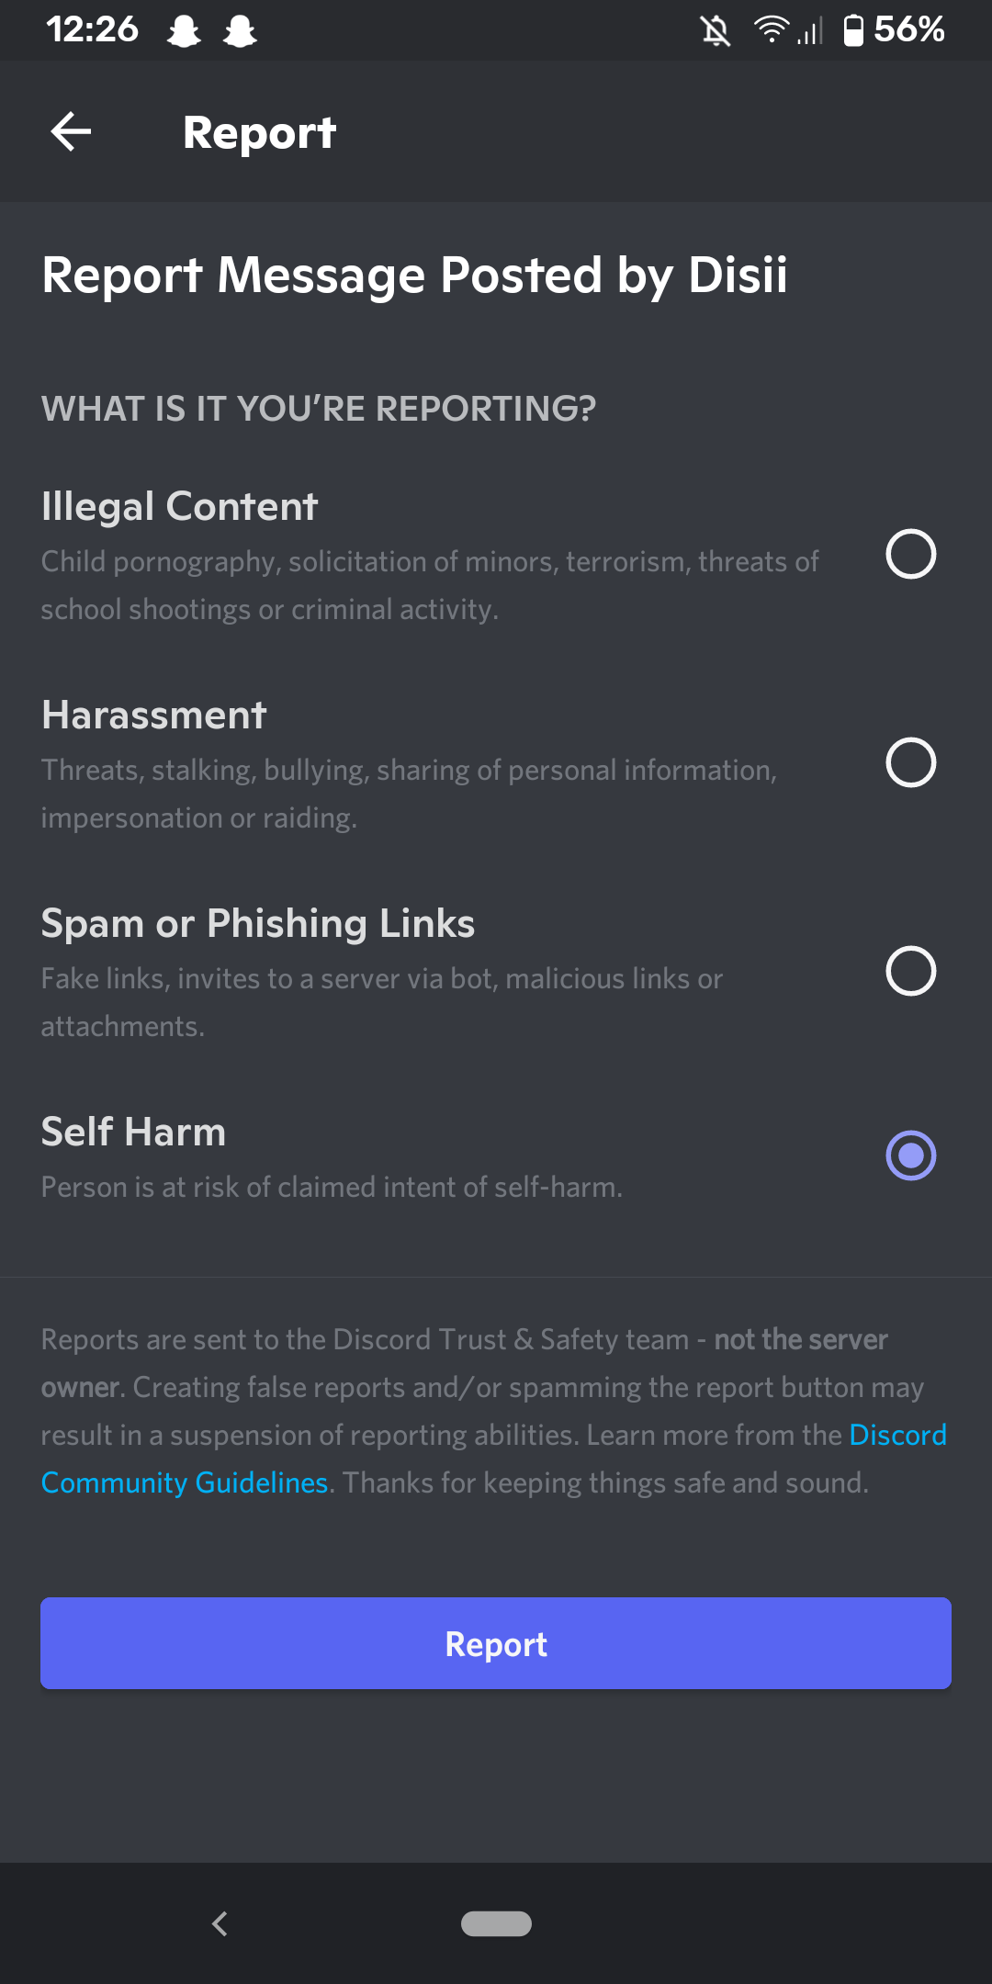
Reporting on Discord
Notes:
You can report a message on discord by clicking on the three dots on the right hand side of the message
And following the prompts
Talk about what happens – person gets a private DM saying someone is worried about them

Slide 25
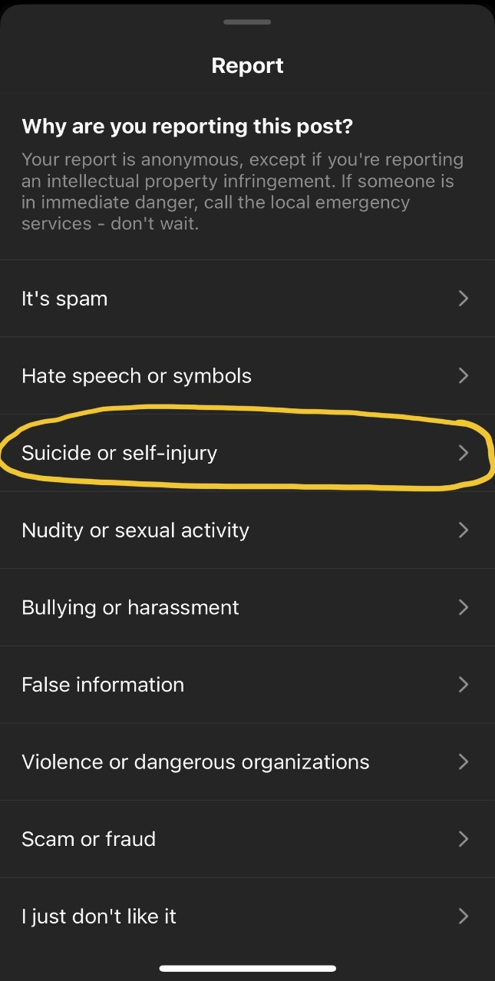
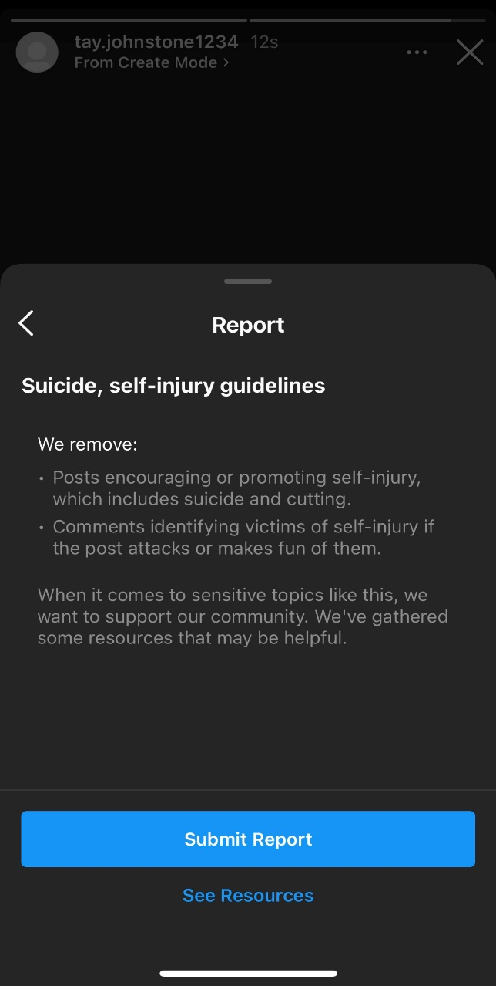
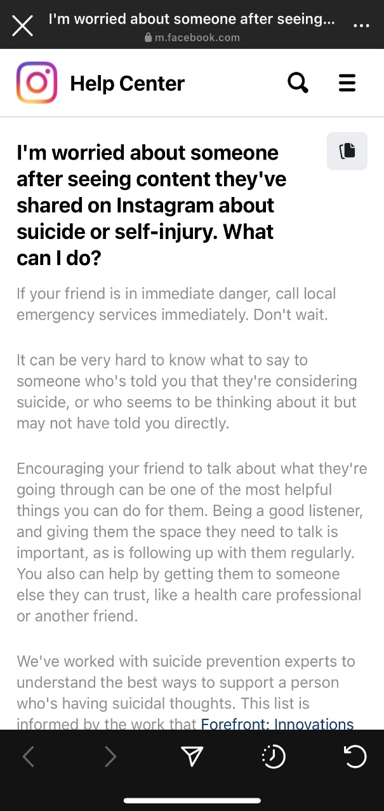
How to Report on Social Media
Notes:
What does reporting mean? What will happen to the person?
Reporting on Instagram - the person will receive a direct message saying someone is concerned about them, message will include suggestion to talk to a friend, direct access to a local hotline, and other tips for getting support

Slide 26
Suicide and Addiction Prevention
Information about how to help a loved one or yourself
Links to other helpful websites for addiction and suicide prevention
Website was designed by an 18-year-old MCPS graduate
btheone_org
@BTheOne_Org

Slide 27
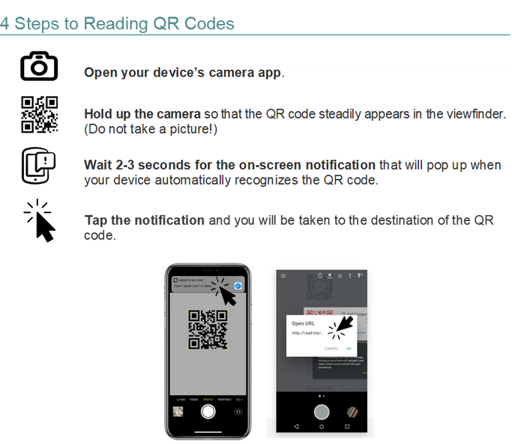
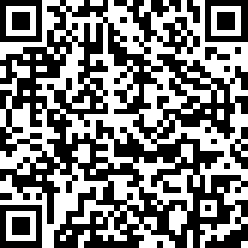
Please share your feedback
www.Every-Mind.org
Notes:
29

Slide 28
Questions?

